Slide 1

全新健康及營養產品巡禮
Health and Nutrition New Products Spotlight

Slide 2


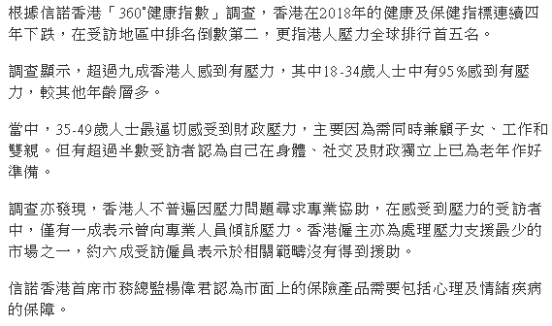
[SURVEY] The Health Condition of the People in Hong Kong Ranked the Second Last.
The 1980s and 1990s are the Most Stressful Group.
Source: https://hk.finance.appledaily.com/finance/realtime/article/20180709/58420866
Notes:
https://hk.finance.appledaily.com/finance/realtime/article/20180709/58420866

Slide 3
SUB-OPTIMAL HEALTH
As defined by the World Health Organization (WHO), health is a “state of complete physical, mental and social well-being and not merely the absence of disease or infirmity.”
In-between health and illness lies a minefield of sub-health symptoms
Notes:
https://www.hkupop.hku.hk/chinese/report/subhealth/content/resources/pr.pdf

Slide 4
Symptoms of sub-health:
Dizziness & headache | Chronic Fatigue | Chest congestion
Aching or tired eyes | Back pain | Breathlessness
Indigestion | Frequent colds | Anxiety
Intolerance to cold | Impaired short-term memory | Sore throat
Difficulty concentrating | Sleep disorders | Low mood
97%
Hong Kong citizens have sub-optimal health
Source: HKU survey
https://www.hkupop.hku.hk/english/report/subhealth/content/resources/pr.pdf

Slide 5


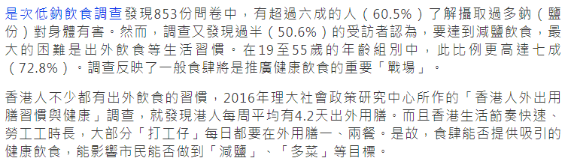
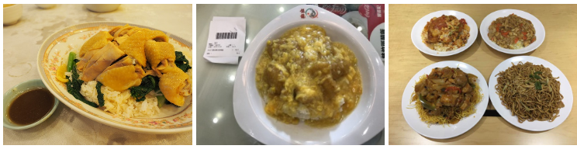
Not effective with the concept of low in salt, sugar and oil. Is it due to lack of knowledge?
Source: https://www.hk01.com/01%E8%A7%80%E9%BB%9E/211372/%E5%81%A5%E5%BA%B7%E9%A3%B2%E9%A3%9F-%E5%B0%91%E9%B9%BD-%E5%B0%91%E7%B3%96-%E5%B0%91%E6%B2%B9-%E4%B8%89%E4%BD%8E-%E6%AC%A0%E6%88%90%E6%95%88-%E6%B8%AF%E4%BA%BA%E7%9C%9F%E7%9A%84%E7%BC%BA%E6%84%8F%E8%AD%98

Slide 6

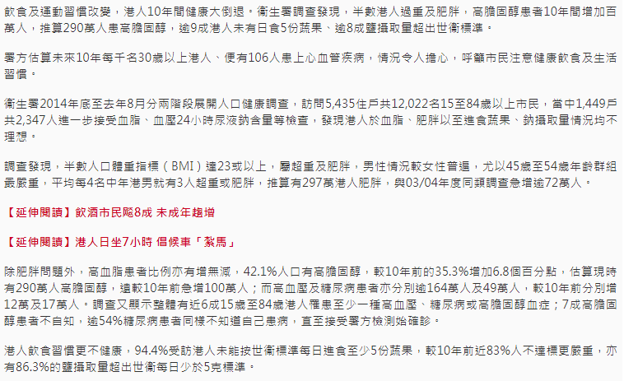
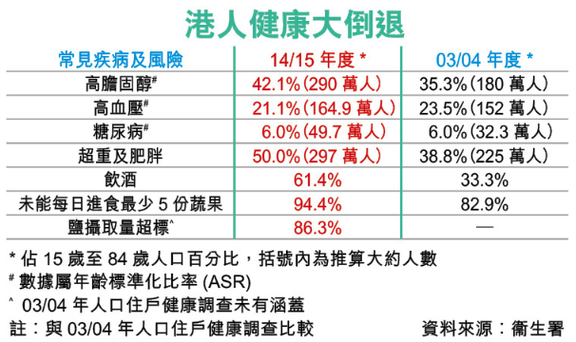
Source: https://topick.hket.com/article/1957337/%E5%8D%8A%E6%95%B8%E6%B8%AF%E4%BA%BA%E8%B6%85%E9%87%8D%20%E9%AB%98%E8%86%BD%E5%9B%BA%E9%86%87%E8%80%85290%E8%90%AC
Notes:
https://topick.hket.com/article/1957337/%E5%8D%8A%E6%95%B8%E6%B8%AF%E4%BA%BA%E8%B6%85%E9%87%8D%20%E9%AB%98%E8%86%BD%E5%9B%BA%E9%86%87%E8%80%85290%E8%90%AC

Slide 7
The Prevalence of Heart Disease in Hong Kong

Slide 8
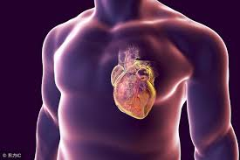
Heart diseases have been the third leading cause of death in Hong Kong since 1960s
"Heart Diseases" refers to a broad spectrum of diseases such as coronary heart disease, hypertensive heart disease, chronic rheumatic heart disease and congenital heart disease.

Slide 9
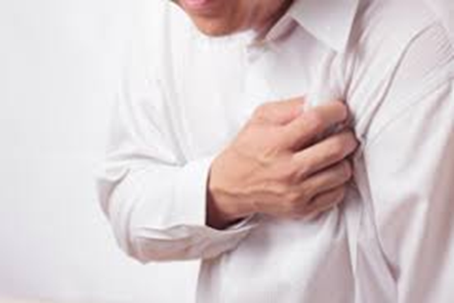
Coronary heart disease is the major cause of death among them. In 2016, about 11.0 persons on average died from coronary heart diseases per day. Moreover, more males died from coronary heart diseases (male to female ratio = 1.5:1)

Slide 10
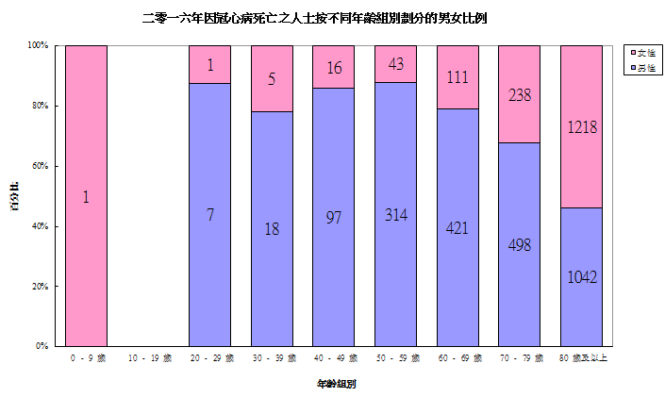

Slide 11
In 2016, 32,800 inpatient discharges and deaths were related to coronary heart diseases

Slide 12
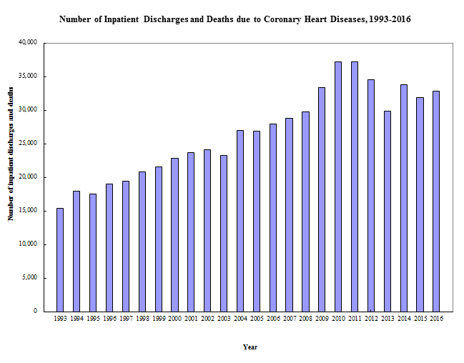

Slide 13
In 2016, the number of deaths were 4,032, accounting for 8.6% of all registered deaths.

Slide 14
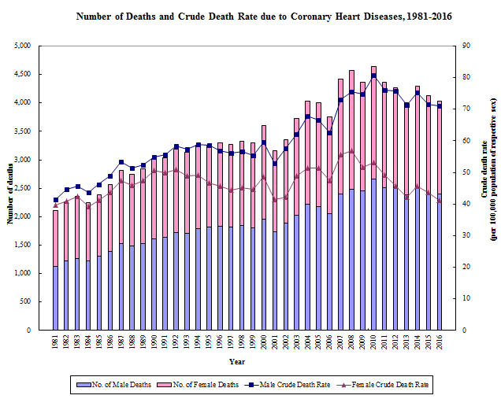

Slide 15
The overall age-standardized death rate of coronary heart diseases showed a slight decreasing trend in recent years.

Slide 16
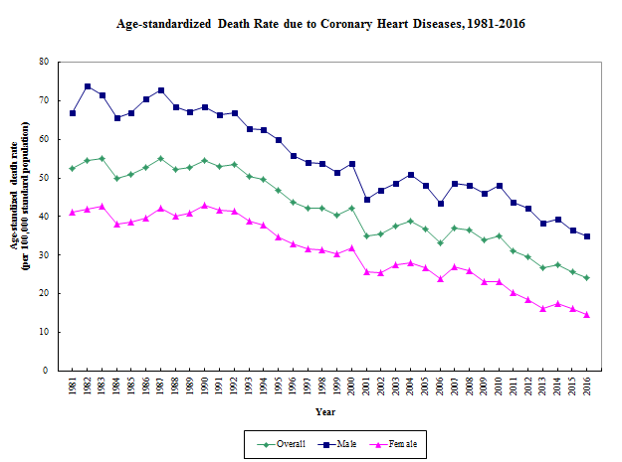

Slide 17
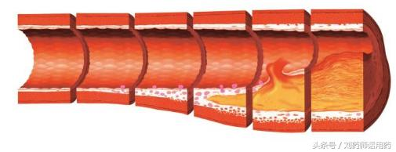
Causes
  As one grows older, fatty tissue deposits as plaques on the inside walls of arteries. This becomes thicker and thicker so that the humen of arteries becomes narrowed. This process is termed atherosclerosis.

Slide 18
If the coronary artery is affected, there will be reduced blood supply to the heart, causing coronary heart disease. If the wall of the plaque ruptures, blood clots will be formed in the arteries. This will lead to blockage of the arteries and result in a heart attack.

Slide 19
Symptoms and Signs
Sudden death without any previous symptoms. About 10% of patients with coronary heart disease do not have symptoms and only present as sudden death.

Slide 20
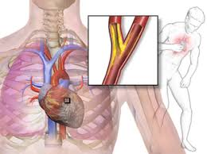
Some people may have the following symptoms
Angina – Constricting chest pain. It usually occurs under physical exertion e.g. while doing exercise, brisk walking or under emotional stress.

Slide 21
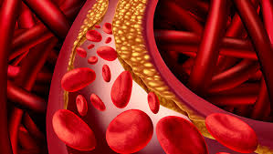
Acute myocardial infarction (heart attack)
  Sudden onset of severe chest pain tha tmay radiate to the neck, arm or jaw. The patient may develop profuse sweating, shortness of breath, nausea and vomiting or even pass out.

Slide 22
Risk factors for coronary heart disease include:
High blood pressure
High blood cholesterol
Smokinig
Family history of coronary heart disease
Obesity or Diabetes mellitus
Lack of exercise
Chronic stress

Slide 23
Choleseterol is an important part of a healthy body as it is important for cell membrane and hormone production.
Low-density lipoprotein (LDL) is often referred to as “bad” cholesterol, while high-density lipoprotein (HDL) is “good” cholesterol. Triglycerides are form of fat made in the body.

Slide 24
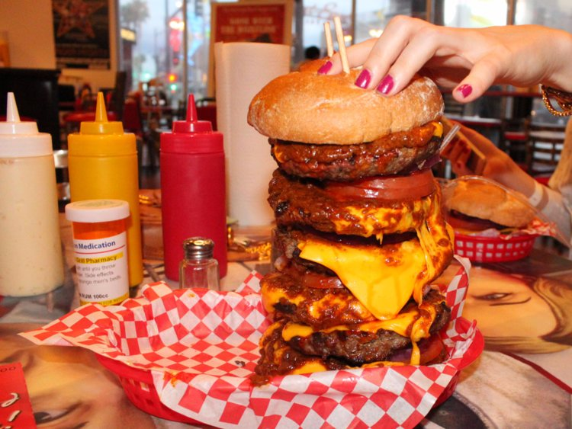
The body naturally produces cholesterol and it can come from food.
Eating saturated fat, trans-fats and dietary cholesterol increases the overall amount of cholesterol in the blood.
Because high cholesterol levels can be dangerous, it is important to maintain healthy levels, both the good and the bad, in the body.

Slide 25
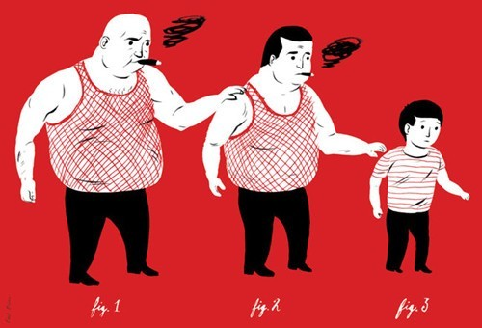
Prevention of coronary heart disease
  Quit smoking and avoid excessive drinking
  Regular exercise
  Eat a balanced, low fat diet
  Avoid overweight and obesity
  Have a regular life and manage stress

Slide 26
Capros
Capros is a super antioxidant and an excellent cardiovascular support product, derived from the edible fruits and Phyllanthus emblica.
Phyllanthus emblica (Indian gooseberry) is native to India and parts of the Middle East and its fruits have been used in Ayurvedic medicine for thousands of years to promote longevity, strengthen the heart and eyes, and boost immunity.

Slide 27
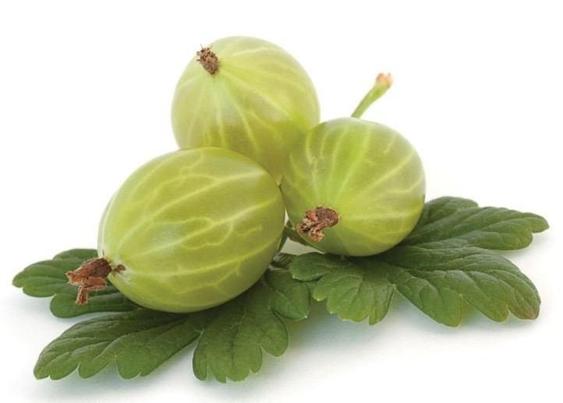
Although small, the fruits are a nutritious source of vitamins, minerals, amino acids, and a diverse blend of polyphenolic compounds. In fact, the edible fruit tissue contains 160 times the vitamins C of an apple

Slide 28
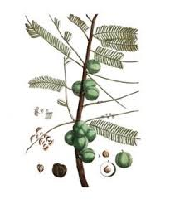
Super antioxidant with ORAC value of 47,000 µmoles TE/g

Slide 29

Do studies back up the claims?

Slide 30
Overweight adult (body mass index: 25 – 35)
- 500mg of CAPROS supplement (12 weeks)
- Placebo group
Supplementation of a Standardized Extract from Phyllanthus emblica Improves Cardiovascular Risk Factors and Platelet Aggregation in Overweight/Class‐1 Obese Adults. Savita Khanna, Amitava Das, James Spieldenner, Cameron Rink, and Sashwati Roy; J Med Food 18 (4)2015, 415–420.

Slide 31
Significant reduction in total cholesterol and LDL was also noted following 12 weeks of CAPROS supplementation
Circulatory high-sensitivity C reactive protein (hs-CRP) levels were significantly decreased after 12 weeks of supplementation

Slide 32
12 volunteer adults
- 500mg of Phyllanthus emblica supplement (14 days)
- Placebo group
Evaluation of Phyllanthus emblica extract on cold pressor induced cardiovascular changes in healthy human subjects. Nishat Fatima, Usharani Pingali, Raveendranadh Pilli; Pharmacognosy Research | January‐March 2014 | Vol 6 | Issue 1.

Slide 33
Phyllanthus emblica extract produced a significant decrease of mean percent change in the indices of arterial stiffness

Slide 34
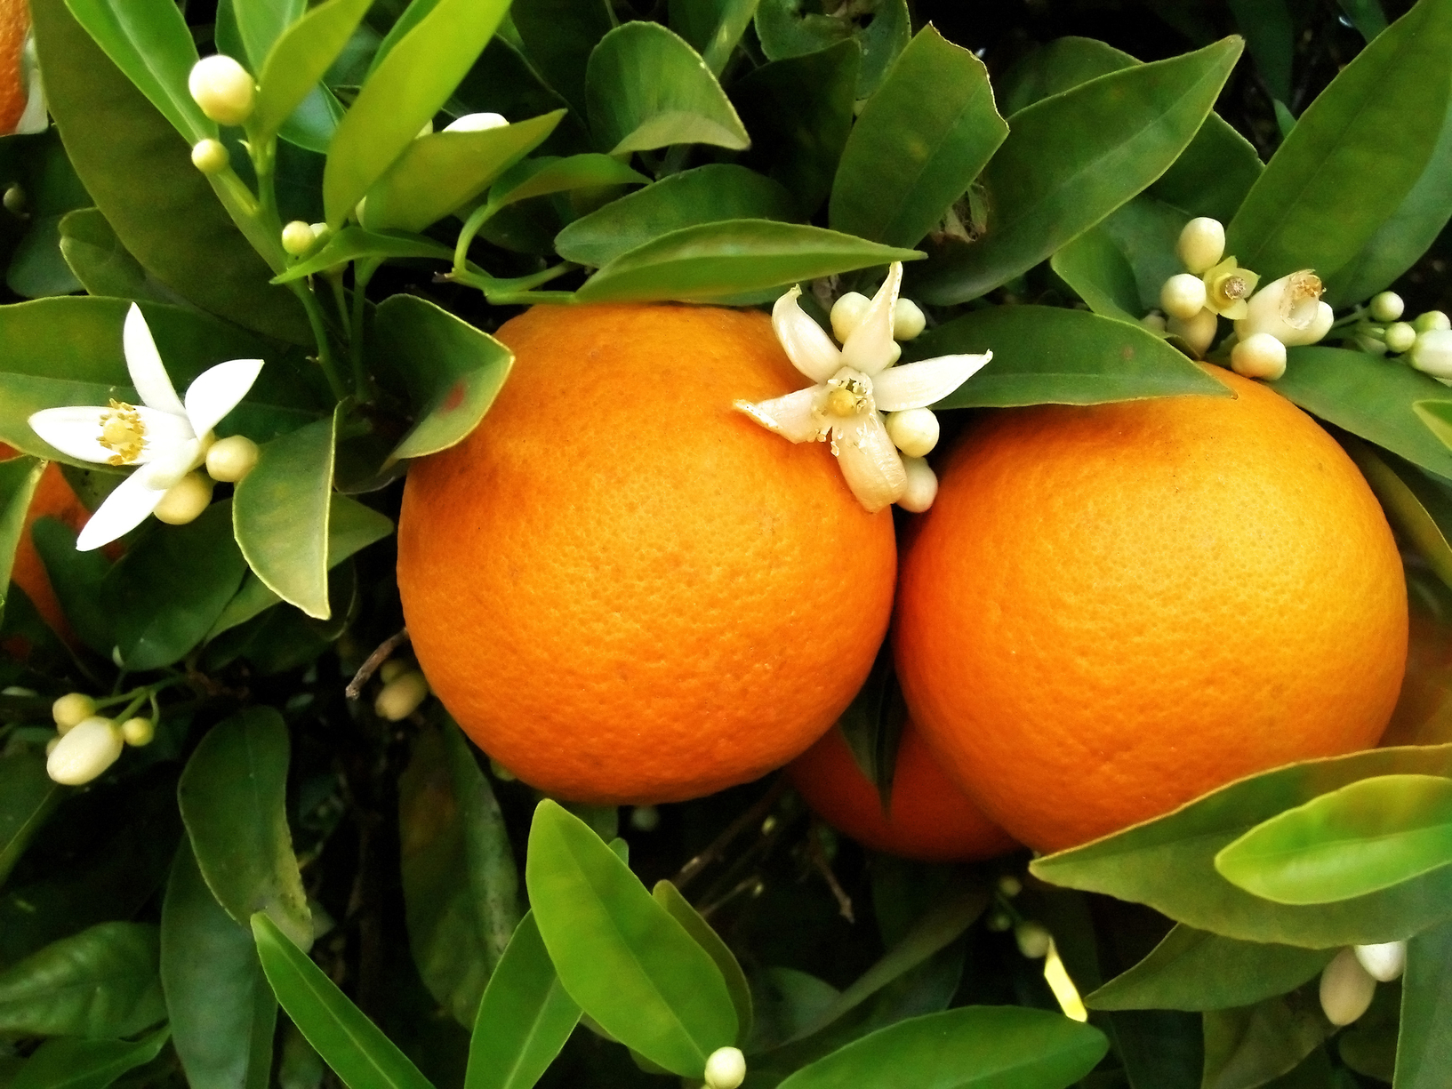
Citrus sinensis fruit
Citrus sinensis fruit, also known as sweet orange, is native to Asia, but is now cultivated in many areas around the world. Sweet oranges contain high levels of vitamin C and potassium.

Slide 35
Citrus sinensis peel contains components known as polymethoxylated flavones (PMFs) which are highly bioactive.
PMFs are beneficial for cardiovascular health. PMFs are beneficial for cardiovascular health by supporting normal triglyceride and cholesterol levels.

Slide 36
These flavones appear to alter the metabolism of lipids in the liver by inhibiting the activity of one of the enzymes necessary for triglyceride synthesis, while increasing the metabolism of fatty acids. PMFs also appear to inhibit the activity of another enzyme required for the transfer of fatty acids into new LDL particles thereby limiting LDL levels.

Slide 37

Be Cholesterol Smart
No more limits on amount of cholesterol intake?
  “2015 Dietary Guideline for Americans” has excluded the recommendation of limiting dietary cholesterol to 300mg/day
Dietary cholesterol is found in foods of animal origin; while foods of plant origin are cholesterol-free
According to the World Health Organization (WHO)’s estimation,
high blood cholesterol causes 2.6 million deaths worldwide each year
Factors affecting blood cholesterol levels:
  Diet – Excessive intake of foods high in saturated and trans fat
  Lack of exercise, excess weight and smoking
  Age and gender
Source: https://www.chp.gov.hk/files/pdf/ncd_watch_sep2011.pdf
Notes:
https://www.chp.gov.hk/files/pdf/ncd_watch_sep2011.pdf

Slide 38
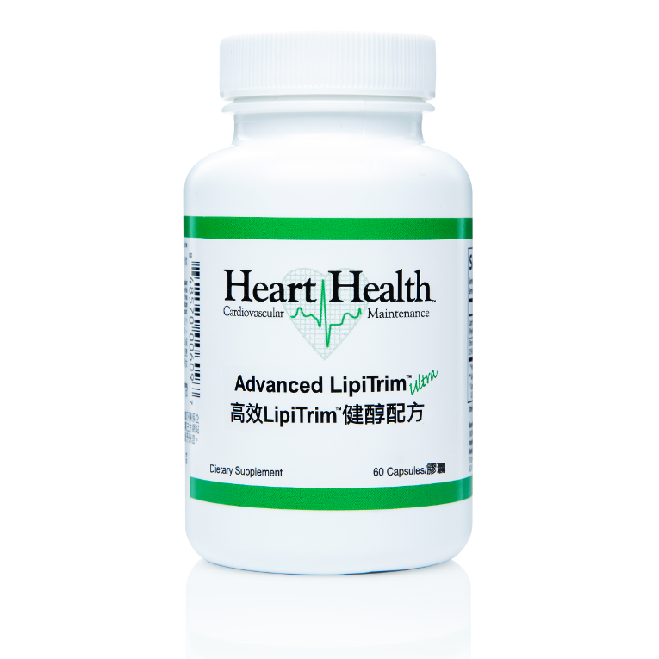

INTRODUCING…
Code: HK13848| UC: HK$288.00 | SR: HK$403.00 | BV: 27.00

Slide 39
BENEFITS
May assist in stabilizing cholesterol, triglycerides and LDL cholesterol*
Helps support healthy cardiovascular function
Supports healthy blood vessels
Provides antioxidant support for the heart
Take 1 capsule in the morning and 1 capsule in the evening for a total of 2 capsules daily.
*This product is not registered under the Pharmacy and Poisons Ordinance or the Chinese Medicine Ordinance. Any claim made for it has not been subject to evaluation for such registration. This product is not intended to diagnose, treat or prevent any disease.

Slide 40
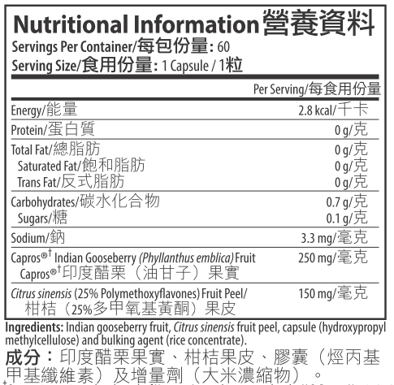

Slide 41
VALUE PROPOSITION
Vegetarian product
Contains patented and a non-GMO ingredient
Capros Indian Gooseberry Fruit & Citrus sinensis fruit peel
Cardiovascular health

Slide 42
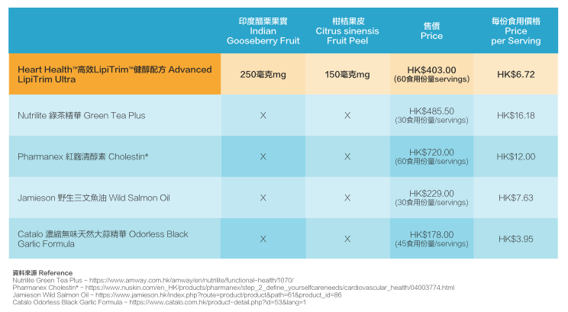
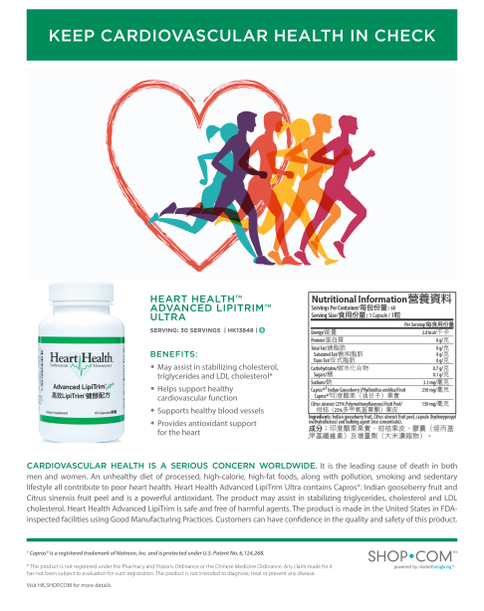
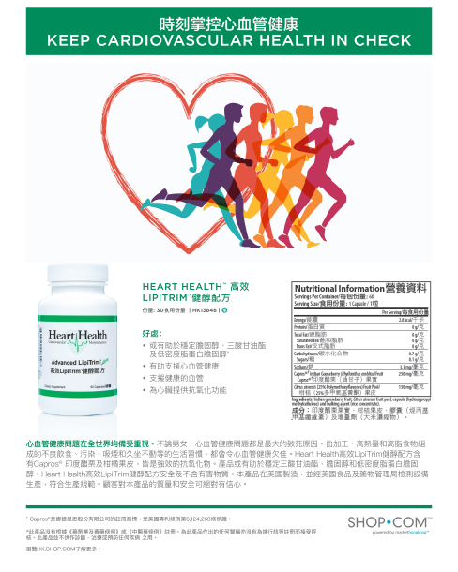

Slide 43

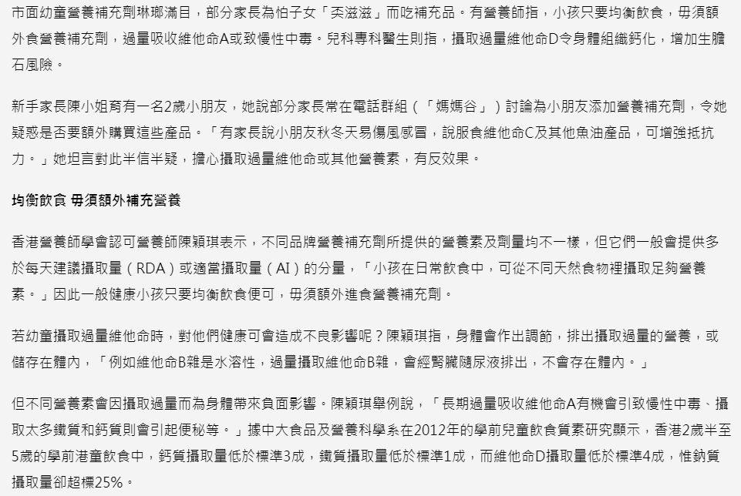
Excessive vitamin intakes for children can be poisoning
Source: https://skypost.ulifestyle.com.hk/article/2169979/%E5%B9%BC%E5%85%92%E6%94%9D%E9%81%8E%E9%87%8F%E7%B6%AD%E4%BB%96%E5%91%BD%20%E6%81%90%E4%B8%AD%E6%AF%92
Notes:
https://skypost.ulifestyle.com.hk/article/2169979/%E5%B9%BC%E5%85%92%E6%94%9D%E9%81%8E%E9%87%8F%E7%B6%AD%E4%BB%96%E5%91%BD%20%E6%81%90%E4%B8%AD%E6%AF%92

Slide 44
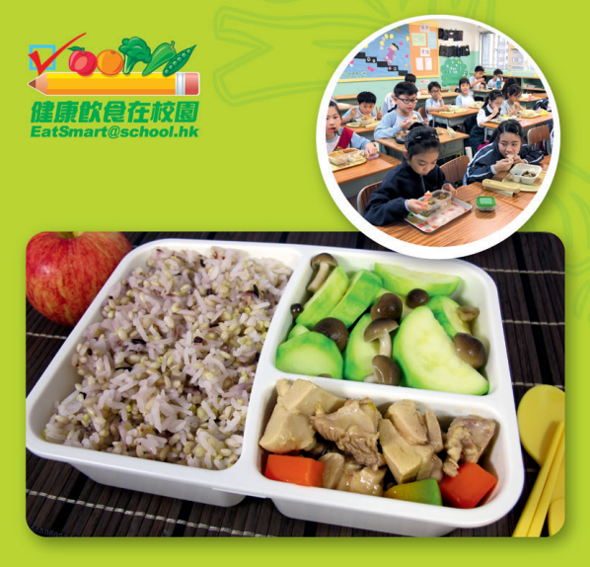
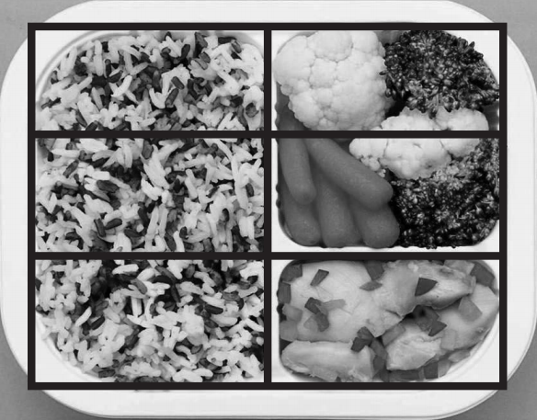

Ratio of 3:2:1
Notes:
https://school.eatsmart.gov.hk/files/pdf/lunch_guidelines_bi.pdf

Slide 45
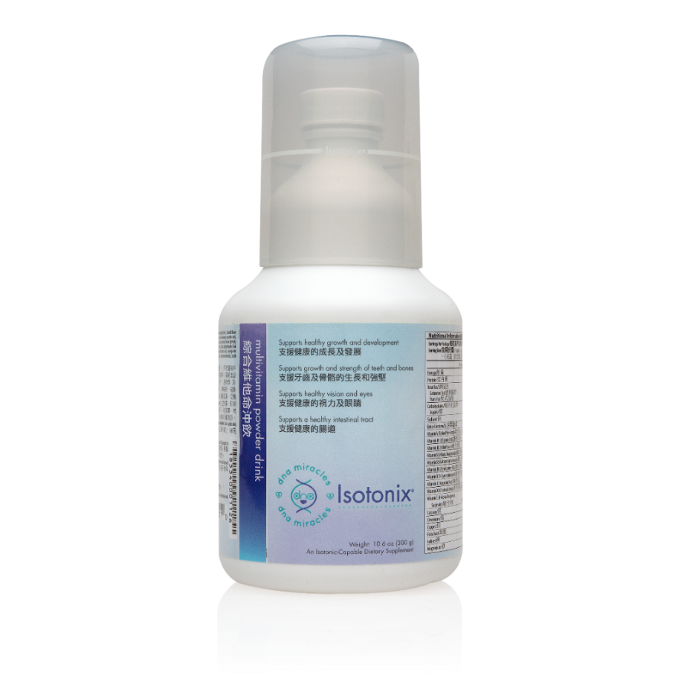

INTRODUCING.....
Code: HK6936| UC: HK$176.00 | SR: HK$247.00 | BV: 13.00

Slide 46
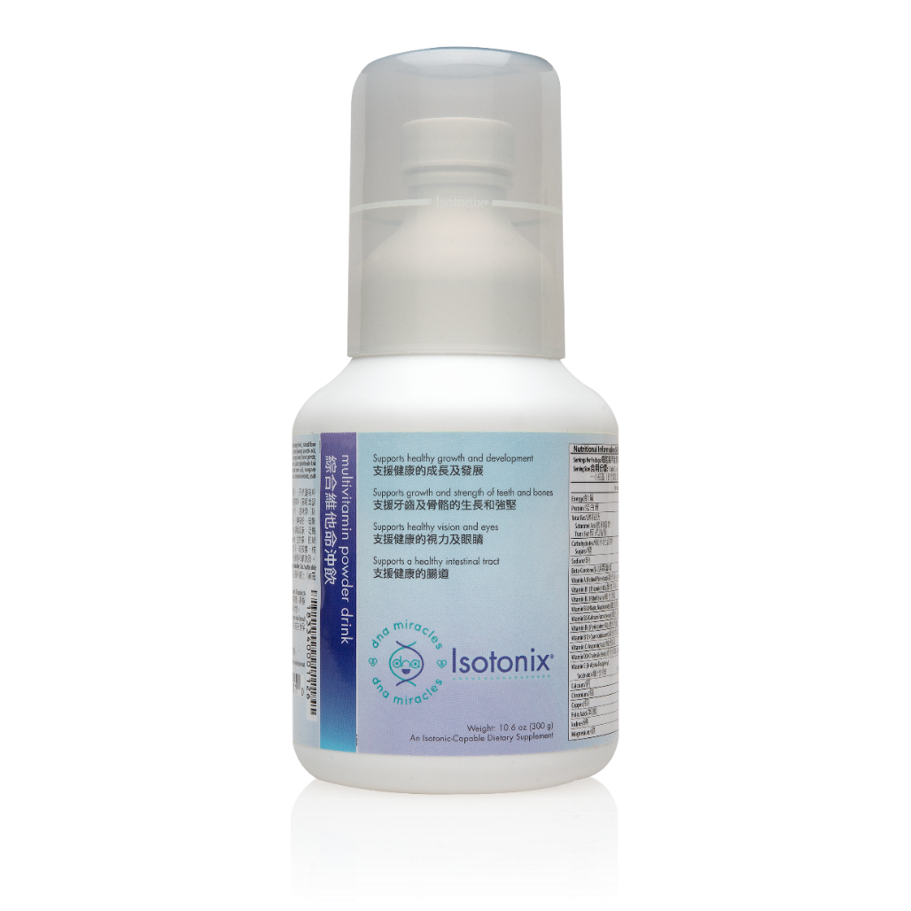
BENEFITS
Supports optimal immune functions
Supports skeletal health and growth
Supports healthy teeth and gums
Supports growth and strength of teeth & bones
Supports healthy growth and development
Supports healthy vision and eyes
Supports a healthy intestinal tract
Promotes normal digestion
Supports a healthy heart
Provide antioxidant protection
Ages 2-3: 1 capful per day.
Ages 4 and older: Take 2 capfuls daily.

Slide 47
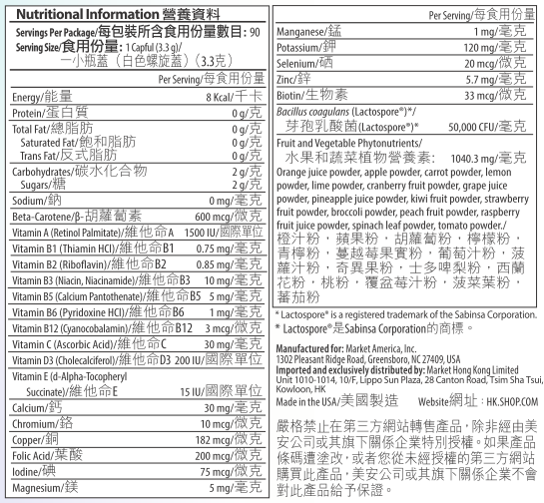

Slide 48
Nutrients | DRIs Age 4-8 | DRIs Age 9-13 | DRIs Age 14-18 | DNA Miracles Multivitamin
Vitamin A | 1350 IU/d | 2000 IU/d | 3000 IU/d | 1500 IU
Vitamin B1 | 0.6 mg/d | 0.9 mg/d | 1.2 mg/d | 0.75 mg
Vitamin B2 | 0.6 mg/d | 0.9 mg/d | 1.3 mg/d | 0.82 mg
Vitamin B3 | 8 mg/d | 12 mg/d | 16 mg/d | 10 mg
Vitamin B6 | 0.6 mg/d | 1 mg/d | 1.3 mg/d | 1 mg
Vitamin B12 | 1.2 mcg/d | 1.8 mcg/d | 2.4 mcg/d | 3 mcg
Vitamin C | 25 mg/d | 45 mg/d | 75 mg/d | 30 mg
Vitamin E | 8 IU/d | 13 IU/d | 15 IU/d | 15 IU
Potassium | 3800 mg/d | 4500 mg/d | 4700 mg/d | 120 mg
Zinc | 5 mg/d | 8 mg/d | 11 mg/d | 5.7 mg
Fruit & Veg Phytonutrients | - | - | - | 1040 mg
https://www.ncbi.nlm.nih.gov/books/NBK56068/table/summarytables.t3/?report=objectonly
https://www.ncbi.nlm.nih.gov/books/NBK56068/table/summarytables.t2/?report=objectonly
Notes:
https://www.ncbi.nlm.nih.gov/books/NBK56068/table/summarytables.t3/?report=objectonly
https://www.ncbi.nlm.nih.gov/books/NBK56068/table/summarytables.t2/?report=objectonly

Slide 49
VALUE PROPOSITION
Vegetarian product
Contains no wheat, soy, yeast, gluten, artificial flavor, starch, salt, preservatives or milk
Contains the essential vitamins and minerals, phytonutrients
Great tasting, highly effective isotonic formula

Slide 50
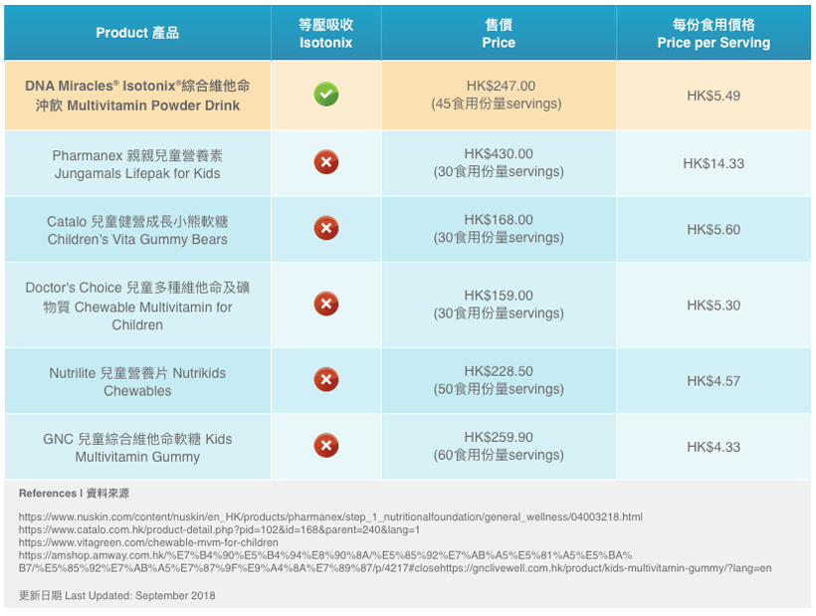

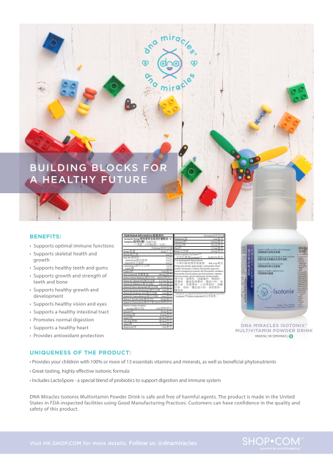

Slide 51
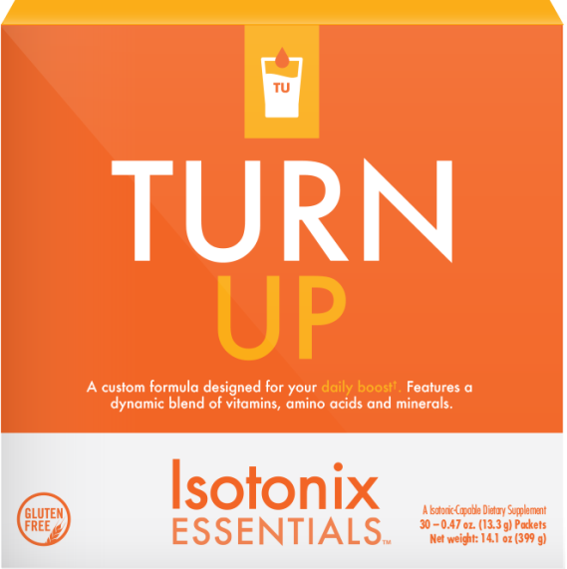
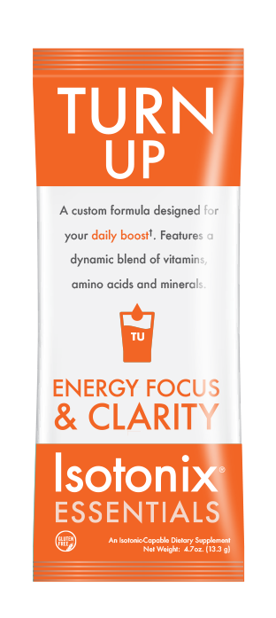

INTRODUCING...
Code: HK6703| UC: HK$474.00 | SR: HK$664.00 | BV: 40.00

Slide 52
BENEFITS
Increases energy
Provides strong antioxidant protection
Helps improve mental focus
Promotes cognitive health
Promotes normal regulation of enzymes
Helps with energy and stamina

Slide 53
MAJOR INGREDIENTS
Features a dynamic blend of vitamins, amino acids and minerals
Açai Fruit
Magnesium
L-Phyenylalanine
Guarana Seed Extract
L-Taurine
Mangosteen Powder
Co-enzyme Q10
Pomegranate Fruit Powder
Yerba Mete Leaf Extract
Green Tea Leaf Extract

Slide 54
VALUE PROPOSITION
Contains no gluten, wheat, soy, yeast, artificial flavors, salt, preservatives or milk
Individually packaged
Synergistic formula of select vitamins, minerals and amino acids
Acai, mangosteen, pomegranate
Mid-morning or mid-afternoon “pick me up”
Take as needed
Notes:
Deedra, comment on synergistic formula of vitamins, Minerals, Amino Acids

Slide 55
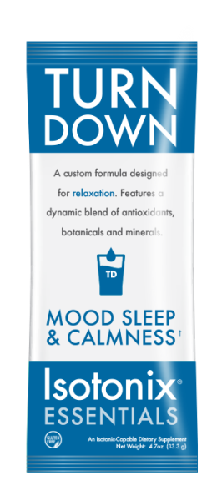
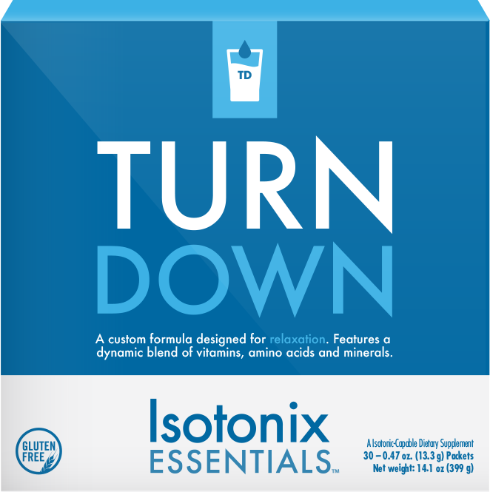
INTRODUCING...
CODE: HK6702 | UC: HK$410.00 |SR: HK$574.00 | BV: 35

Slide 56
BENEFITS
Helps enhance and stabilize mood
May promote calmness and relaxation
Supports healthy sleep quality
Promotes sleep
Assists in releasing mental tension
Helps to clear the mind
Promotes normal regulation of enzyme
Promotes cognitive health
Notes:
Deedra Sleep quality

Slide 57
MAJOR INGREDIENTS
Features a dynamic blend of vitamins, amino acids and minerals
L-Tryptophan
Vitamin C
Potassium
Calcium
Magnesium
Niacin
Vitamin B6
Vitamin B2
Manganese
Notes:
Deedra Sleep quality

Slide 58
VALUE PROPOSITION
Contains no gluten, wheat, soy, yeast, artificial flavors, salt, preservatives or milk
Individually packaged
Synergistic formula of select vitamins, minerals and amino acids
Take as needed
Notes:
Deedra formula of select vitamins, Minerals and amino acids

Slide 59
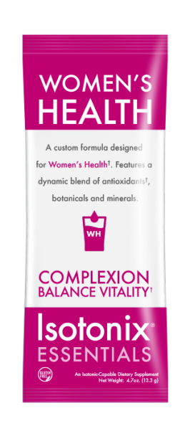
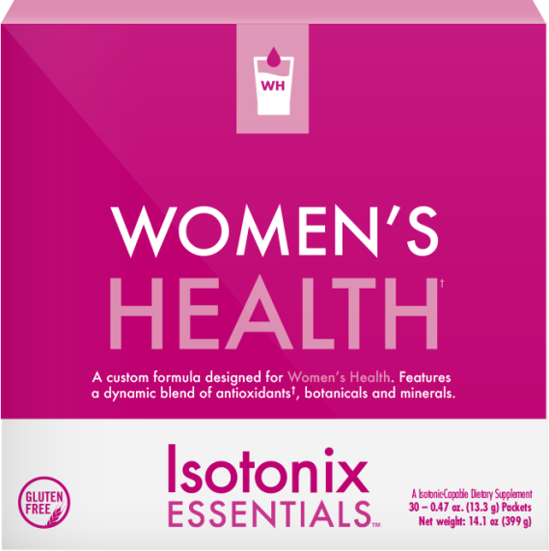
INTRODUCING...
CODE: HK6701 | UC: HK$474.00 |SR: HK$664.00 | BV: 40

Slide 60
BENEFITS
Supports a healthy complexion
Promotes healthy functioning of the skin at a cellular level
Helps maintain normal cell health
Helps maintain healthy collagen production
Provides antioxidant protection for the entire body
Helps support healthy bones, teeth, joints and skin
Supports cardiovascular health
Notes:
Deedra to have open opportunity on comments, Dennis to pul her in

Slide 61
MAJOR INGREDIENTS
Features a dynamic blend of antioxidants, botanicals and minerals
Pine Bark Extract (Pycnogenol®)
Grape Seed Extract
Bilberry Extract
Citrus Bioflavonoid Complex
Red Wine Extract
Hyaluronic Acid
Calcium, Magnesium, Potassium
Vitamin C, Vitamin E etc.
Notes:
Deedra to have open opportunity on comments, Dennis to pul her in

Slide 62
VALUE PROPOSITION
Contains no gluten, wheat, soy, yeast, artificial flavors or preservatives
Individually packaged
Supports healthy hair, skin and nails
Select vitamins and minerals
Notes:
Dennis to finish segment

Slide 63
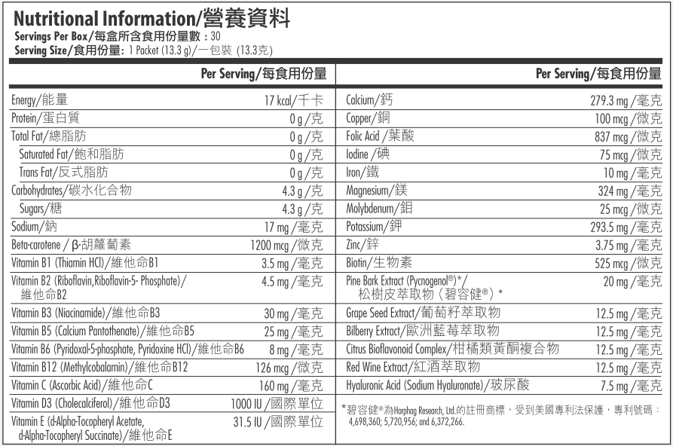
Notes:
Deedra to have open opportunity on comments, Dennis to pul her in

Slide 64
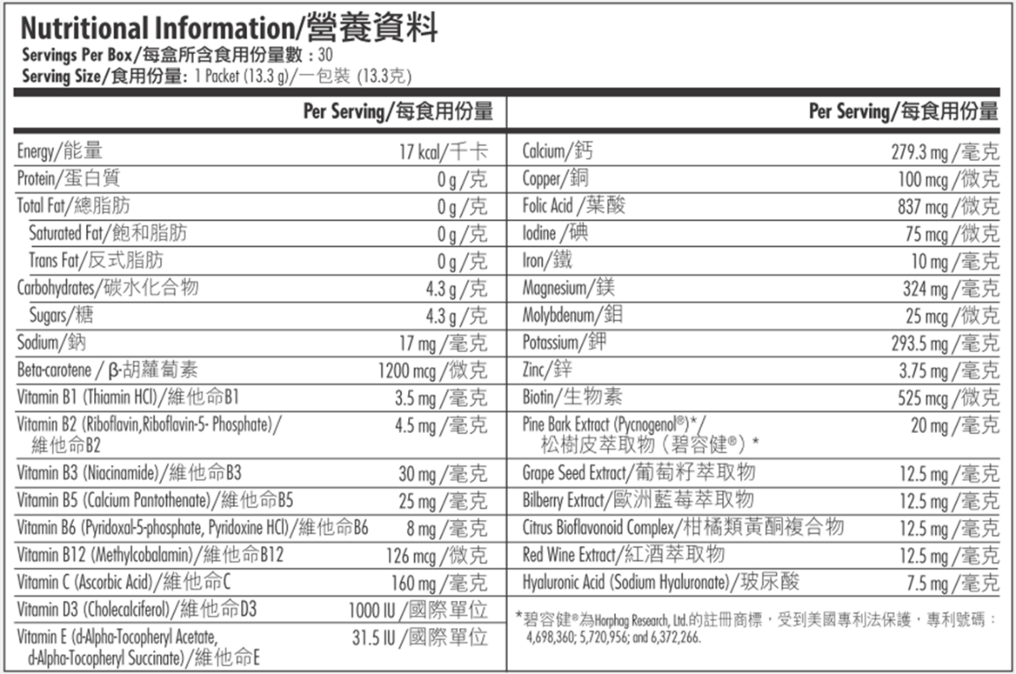
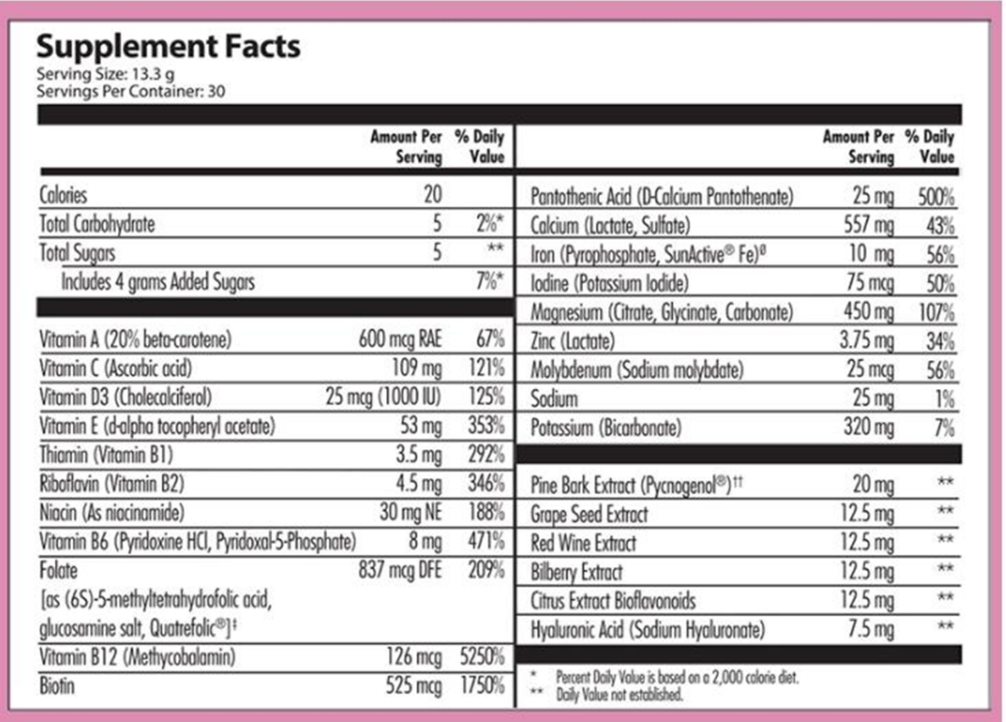

Slide 65
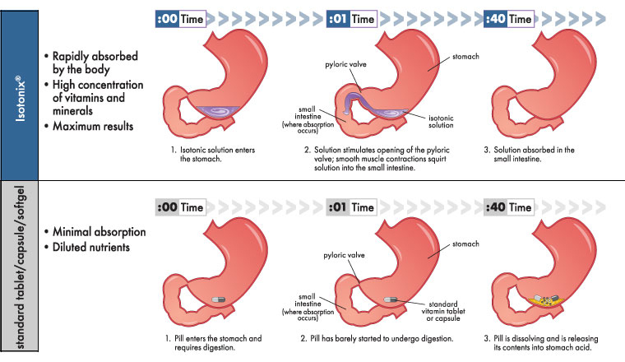
Isotonix等壓吸收
快速被身體吸收
維他命及礦物質的濃縮品
發揮最大效能
標準片劑/膠囊軟膠囊
最低吸收量
稀釋營養素
Notes:
This illustration has been used for quite some time to introduce new customers to the advantages of isotonix delivery. However many distributors and customers – especially those with a medical background – would like a more in depth and scientific explanation. So today, I am going to the science behind isotonix delivery in a way that you will easily understand and remember.

Slide 66
For translation:
ISOTONIX OPC-3® FORMULATION VS. TABLETS
Phytotheraphy Research 2009 (June:23(6) 775-7
Notes:
Accelerated antioxidant bioavailability of OPC-3 bioflavonoids administered as isotonic solution. Cesarone et al. Phytotherapy Research 23, 775-777(2009).
Plasma radical reduction rate (PRRE) higher the bar (units) greater antioxidant activity
Free radicals being reduced or quenched (6x greater than OPC-3 at 10 minutes. After 20 mins (4x more bioavailable-BA), 40 minutes (2x) Isotonic OPC-3 more BA throughout 4 hours.

Slide 67
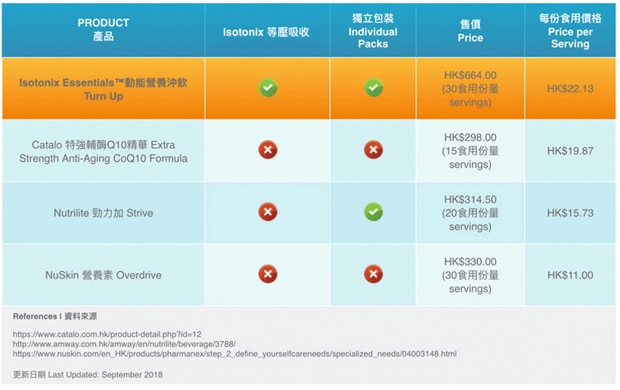
VS. COMPETITORS

Slide 68
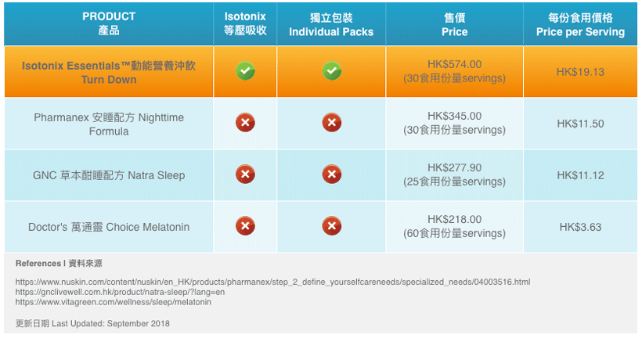
VS. COMPETITORS

Slide 69
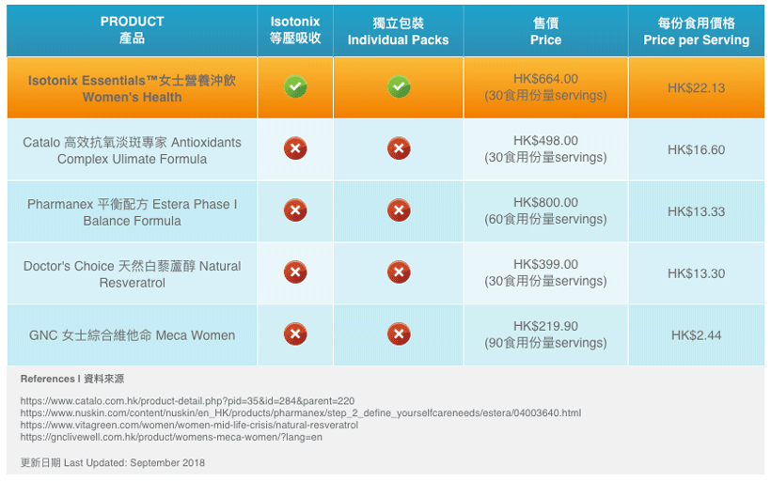
VS. COMPETITORS
Notes:
Dennis to finish segment

Slide 70
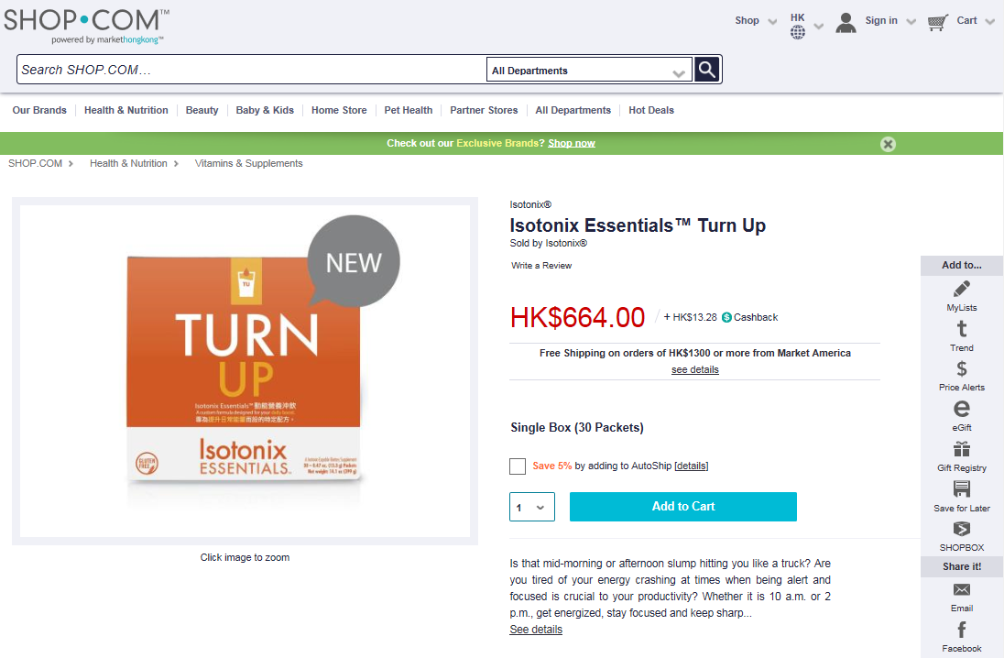
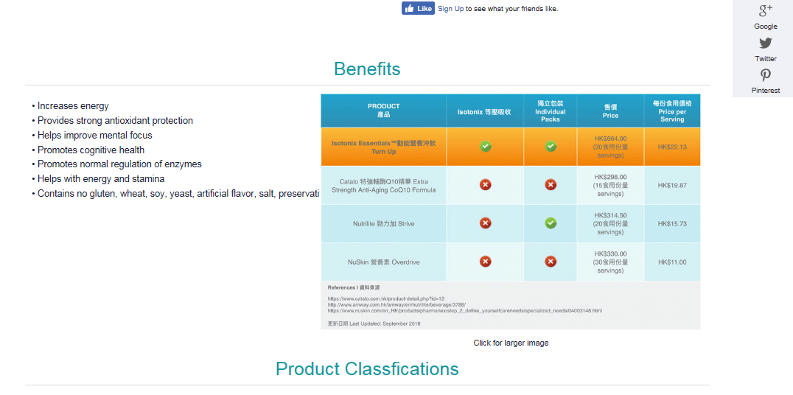
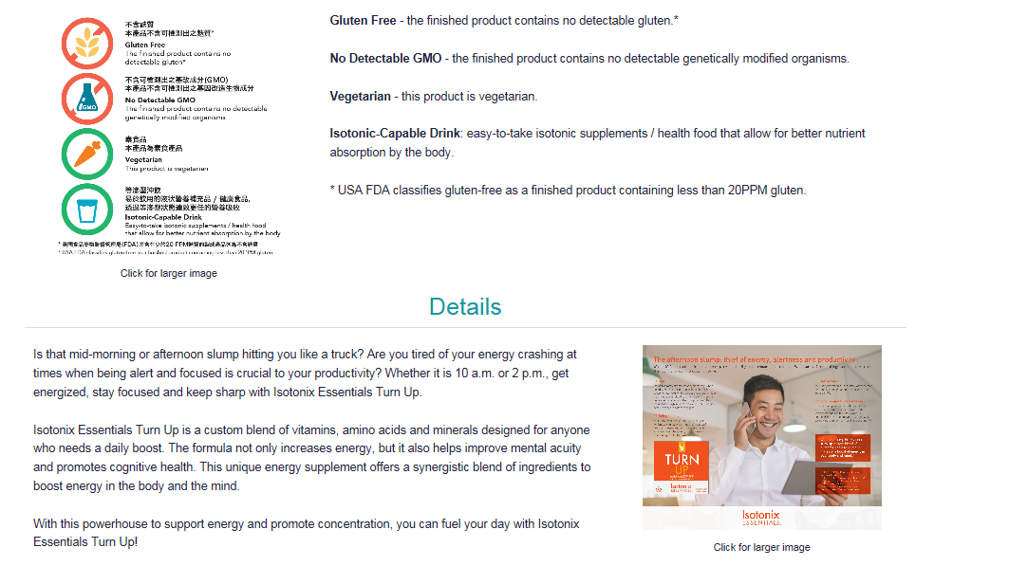

Slide 72

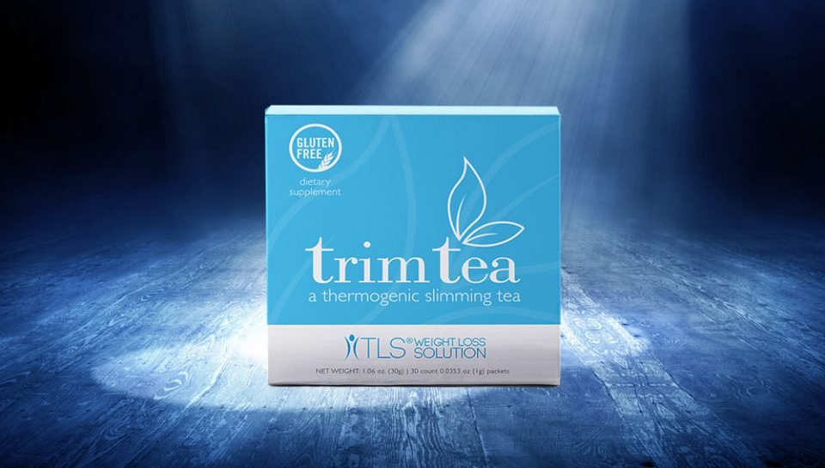

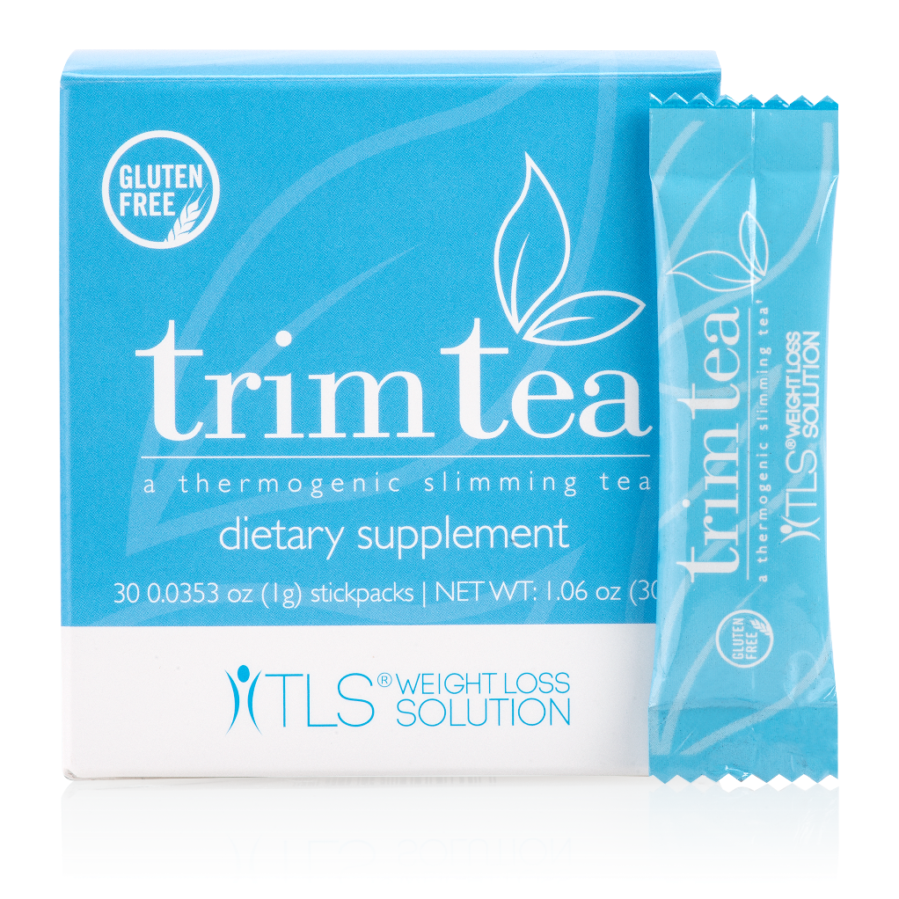
Gluten-Free
Helps curb appetite
Promotes healthy weight loss

Slide 73




RAVE REVIEWS!

Slide 74
RAVE REVIEWS!
I began using Trim Tea this spring to help with weight loss. At the time I was a full time graduate student and also working full time and had little time to donate to exercise. The first month I used Trim Tea with making no adjustments to my eating behaviors I lost 9 pounds. I was pleasantly surprised, and continued to use Trim Tea a second month, and without changing my diet or exercise lost another 7 pounds… Taste is also good, I would add honey and coconut milk to the tea which was excellent tasting when I wanted some added sweetness…

Slide 75

How many of you love to drink coffee?

Slide 76



INTRODUCING
THE REVOLUTIONARY NEW COFFEE PRODUCT!
Notes:
Reference trim café booth

Slide 77


Helps curb appetite
May promote a feeling of fullness
Promotes healthy weight management
Supports metabolic balance and wellness
May assist in stabilizing blood sugar and cholesterol*
Supports cardiovascular health
*This product is not registered under the Pharmacy and Poisons Ordinance or the Chinese Medicine Ordinance. Any claim made for it has not been subject to evaluation for such registration. This product is not intended to diagnose, treat or prevent any disease.

Slide 78




Slide 79

TLS® Trim Café
TLS® Trim Café (15 servings)
Code: HK6612
UC: HK$243.00 |SR: HK$341.00 | BV: 22

Slide 80

OUR NEXT MISSION:
Provide Every Day Consumable Products

Slide 81


Is this
You USE Every morning?

Slide 82


Shopping Annuity
Toothpaste

Slide 83
Shopping Annuity™ Brand Premium Natural Whitening Toothpaste
Supported by bromelain and papain.
Contains:
2 enzymes that whiten teeth
Calcium carbonate polishing agent
No artificial colors, flavors or sweeteners
Our toothpaste contains these two proteolytic enzymes that have been shown to help whiten teeth. Calcium carbonate, a commonly used polishing agent, is also used to support teeth whitening.Our toothpaste contains no articial colors, avors or sweeteners. Just ingredients that gently clean and whiten your pearly whites, with stevia, xylitol and a blend of natural avors to create a fresh, minty taste.Convert brushing into earning with Shopping Annuity Premium Natural Toothpaste!STOP BY THE SHOPPING ANNUITY BOOTH AT MAWC2018
Best In Class!
BV

Slide 84

RAVE REVIEWS!

Slide 85

We promised you there would be more…
And we are delivering!

Slide 86

How many of you regularly wash your hands?
How would you like to earn BV for washing your hands?

Slide 87


Organic Hand Soap
Cleanses & Moisturizes all skin types
Free of
  Detergents
  Sulfates
  Fragrances & alcohol
  Artificial colors
  GMOs
Certified USDA Organic
COMING SOON!
SA Organic Foaming Hand Soap
CODE: HK1401 | UC: HK$87.00 | BV: 4
Notes:
Introducing… then bring in the handsoap
All countries

Slide 88










Shopping Annuity
Organic Hand Soap
BV
$479.00
16 oz.
$29.94 per oz.
$168.00
8 oz.
$21.00 per oz.
$149.00
8.4 oz.
$17.74 per oz.
$87.00
8 oz.
$10.88 per oz.

Slide 89

How many of you regularly use a deodorant?

Slide 90

How would you like to earn BV for using deodorant?

Slide 91


Free of aluminum, parabens & silicones
Safe for all skin types
Cruelty Free
Fresh Clean Scent
For both Men & Women!
COMING SOON!
SA Premium Deodorant
CODE: HK1401 | UC: HK$87.00 | BV: 4
Notes:
All countries

Slide 92





BV
$192.00
2.53 oz.
$75.89 per oz.
$135.00
2.7 oz.
$50.00 per oz.
$145.00
1.9 oz.
$76.30 per oz.
$87.00
2 oz.
$43.5 per oz.
Shopping Annuity
Deodorant
Notes:
Speedstick
Dial

